Slide 1
Understanding Business Personal Property

Slide 2
Business Personal Property …
or BPP is tangible property owned and used by a business for the production of income. BPP is generally movable and is not affixed to or associated with the real property (structures and land). Like real property, BPP is taxable in Texas and is valued by the central appraisal districts. BPP is primarily composed of fixed assets and inventory.

Slide 3
Fixed Assets:
Also known as “use” assets, they’re items commonly described as furniture, machinery, signs, some leasehold, office equipment, electronics, computer and data equipment, vehicles and trailers, aircraft, watercraft and any other kind of asset that is held by its owner to be used for the purpose it was created.

Slide 4
Inventory & Supplies:
BPP that is held by a commercial or industrial enterprise for consumption, processing or sale. Inventory can also be described as raw materials, foods in process, finished goods, goods held for sale, consigned goods and floor planned goods.

Slide 5
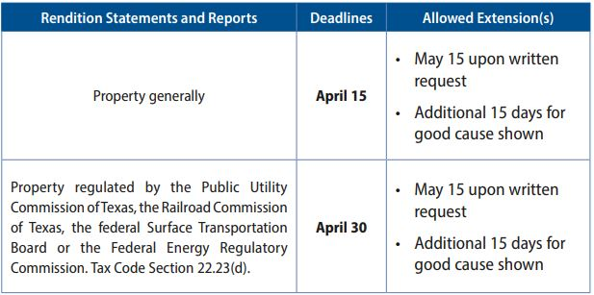
BPP Rendition Overview
A rendition is a form used to report all taxable property (fixed assets and inventory) owned as of January 1, tax code section 22.01.
State law requires on or before April 15th a person shall render for taxation all tangible personal property owned for production of income that the person owns or manages and controls as a fiduciary on January 1. A penalty of 10% of the tax liability will be imposed for failure to file a timely rendition.
If you would like an extension written request can be made before April 15th
Providing detailed cost information in your rendition will greatly aid in our efforts to accurately appraise your business

