Slide 1
WELCOME
VICTORIA CENTRAL APPRAISAL DISTRICT’S
PUBLIC EDUCATION SEMINAR

Slide 2
What we will cover
…
Understanding Exemptions
How to Read Your Notice
Scheduling an Informal Meeting
How to File a Protest
How to Read Your Property Card
Evidence for a Hearing
Market Information
Protest Procedures

Slide 3
Exemptions
Homestead
Over 65
Disabled Persons / Veteran
Other Exemptions
Notes:
If you have any additional questions on exemptions please stop by or call the office and we will be glad to answer any questions that you may have.

Slide 4
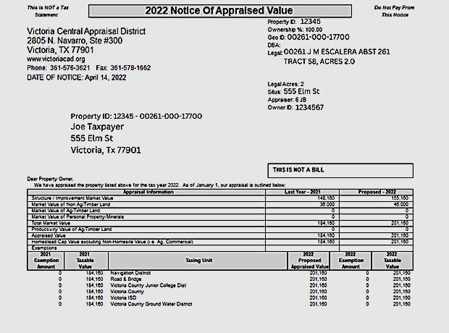
Notes:
Every year around April 15th, you receive your property value notice in the mail.

Slide 5
Notes:
Once you receive your notice, if you have questions please call us and set up an informal meeting. We will answer any questions or concerns that you have and can advise you what information we will need. IF you are still not happy you can file your protest by May 15th for most properties.

Slide 6
Ways to File Your Protest
DROP OFF OR MAIL TO:
VCAD attn: Protest
2805 N Navarro St. STE 300
Victoria, Tx 77901
EMAIL TO:
Vcadprotest@gmail.com
*ONLINE AT:
Victoriacad.org
*only for select properties
Notes:
Online is only for qualifying properties

Slide 7
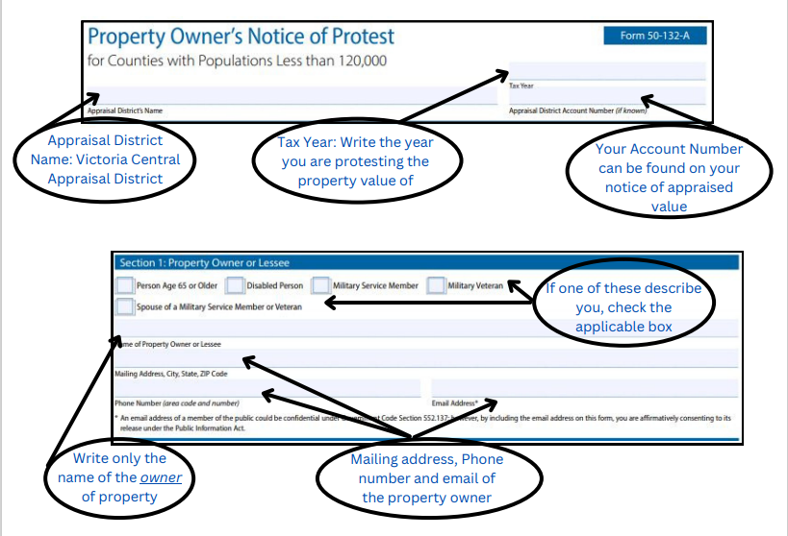
How to Fill Out your Protest Form
Notes:
It is important to turn in a completed form or we may not be able to process it. By skipping boxes we may not know which property or what type of hearing you would like.

Slide 8
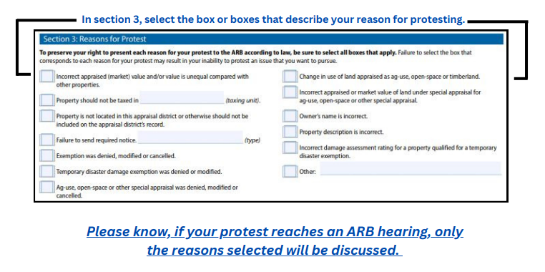
Notes:
You can check all of the boxes, however this can slow down your hearing because then the ARB will need to address each box checked. There are no temporary disaster damage exemptions currently approved for Victoria County, the Governor has not issued any for 2023.

Slide 9
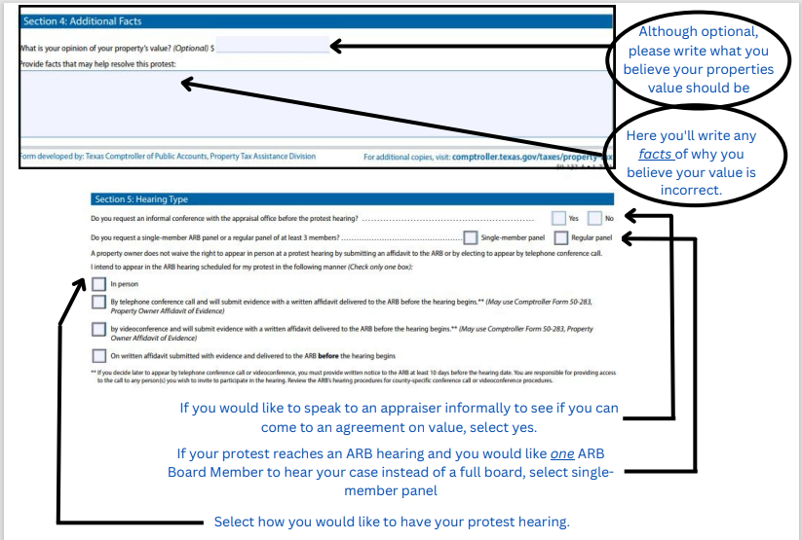
Notes:
If you check no to an informal we will not reach out prior to your hearing. Hearing type- video conference is currently not offered in Victoria County

Slide 10
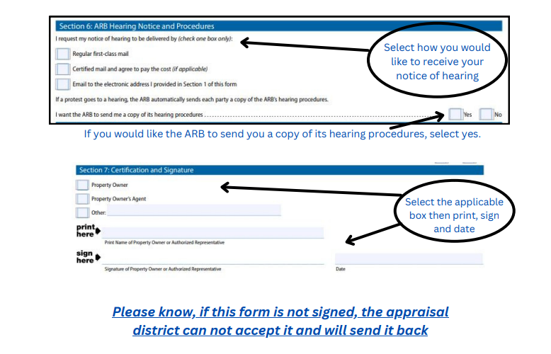
Notes:
How would you like to receive your notice of hearing? If you file online, you will receive it through email and mail. Please be sure to provide a good email address.
IF you want the notice mailed certified, then payment must be made before you can process and mail

Slide 11
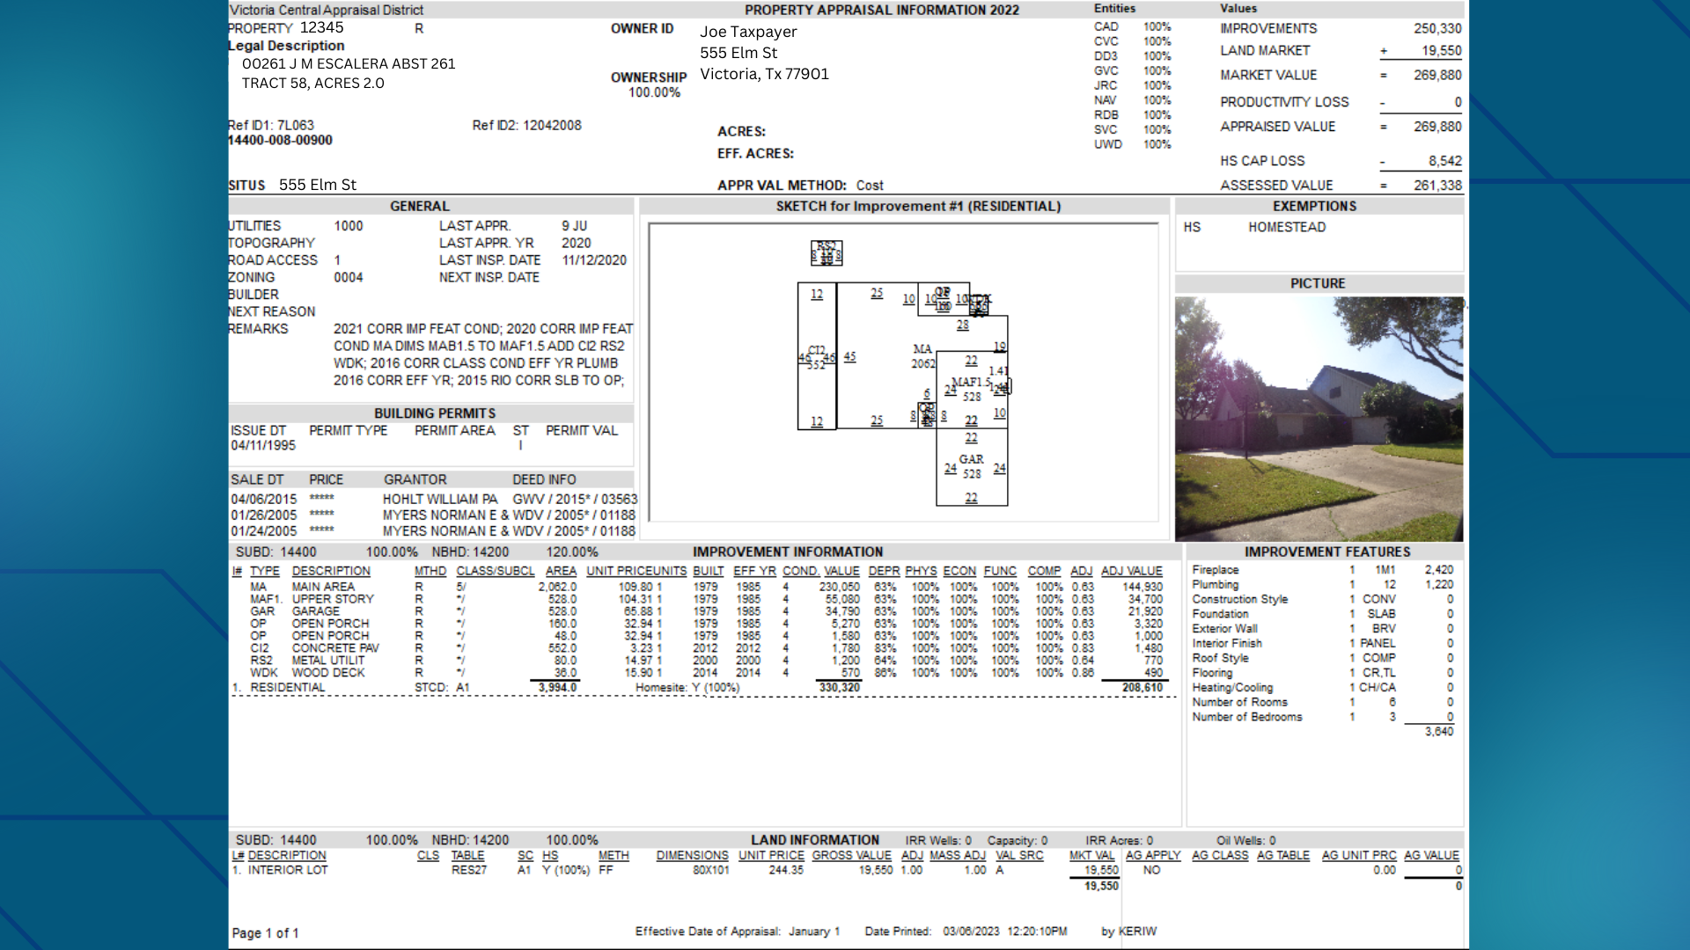
Property Card

Slide 12
Evidence to Bring to your Hearing
Clear date-stamped photos of your property
must be physical photos that
will not be returned. No more than15
Purchase price if obtained recently
Sales of comparable homes in your neighborhood
6 Copies for the ARB and appraiser
Notes:
VCAD will not accept thumb drives with photos as we do not have this set up in the ARB. If you bring photos on your phone, the ARB will not be able to view them, or they will need to submit your device into evidence. Comparable properties must be closed transactions. We can not consider listed properties.

Slide 13
What Does Not Effect Value
Driveways
Sidewalks
Fences
Landscaping
Standard Maintenance Items

Slide 14
Notes:
This was published in the Advocate back in March and the number were provided by the VAAR. Our paired sales indicate 20-60% depending on style and location the median is 40% which is in line with this report.

Slide 15
Protest
Procedures

Slide 16
What Procedures Are New For 2023
Informal Process
Expedited Hearings
Single Panel Waiver
Queuing for formal protest

Slide 17
For Your Information . . . . . . Your scheduled appointment is as reflected on the Notice of Hearing. Please note that you are one of five other appointments scheduled for this time period. Please sign in upon your arrival – you will be called on a first-come, first-served basis BY the appraiser assigned to you. Therefore, your wait time may vary based on how quickly the appraiser completes the previously scheduled appointment. (In the past, wait time varied from 15 minutes to approximately 1 hour and 15 minutes). If you are not present when your name is called, you will be skipped and worked in as time allows. Every effort will be made to see you as quickly as possible. However, we wanted you to know upfront that you should allow enough time for your visit.
Notes:
This paragraph will be on everyone's notice of hearing.

Slide 18
Questions
Notes:
If you have questions, please call our office, and we will try to answer them.

