Slide 1
HOW TO FILL OUT THE 1-D-1 AGRICULTURAL APPLICATION

Slide 2
Fill Out VCAD's Info
Victoria Central Appraisal District
2805 N. Navarro St., Ste. 300, Victoria, Texas 77901
361-576-3621
Note: We will typically enter this for you, but if you get the form from somewhere else, you need to make sure and fill this section out.

Slide 3
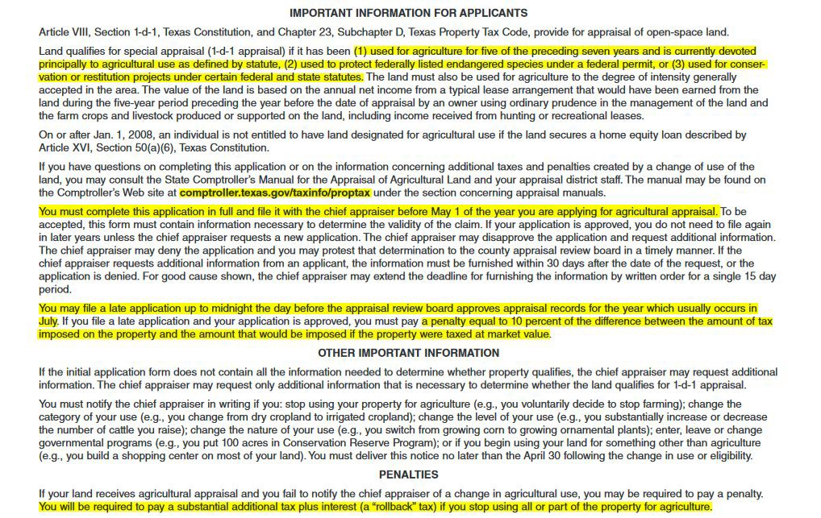
Read the Important Information Sections

Slide 4
Complete STEP 1
2023
Simply type or write in the tax year for which you wish to qualify.
Typically, this will be the current year.

Slide 5
Complete STEP 2
John Doe
123 Main Street
Victoria, TX 76821 10/11/1951
361-555-5555
Enter the name and contact information of the property owner. If the farm or ranch is owned by a trust, corporation, or other business entity, please use the name of the business or trust. Make sure to input the mailing address if not the same as the physical address.
Note: The owner's date of birth isn't required, but it helps us make sure you receive all the tax assistance for which you qualify.

Slide 6
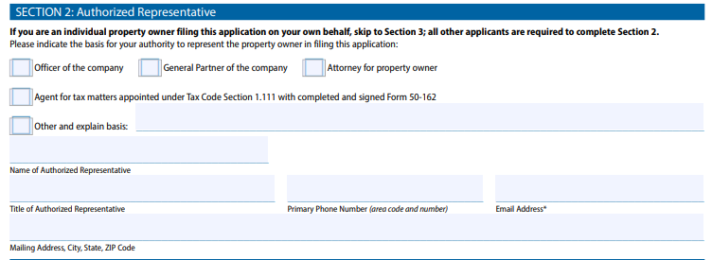
Step 2 continued
If you are an individual land owner skip this section. If the property is owned
by a legal entity or you’re submitting this on the behalf of another person, complete this section to identify your legal ability to act on the behalf of the property

Slide 7
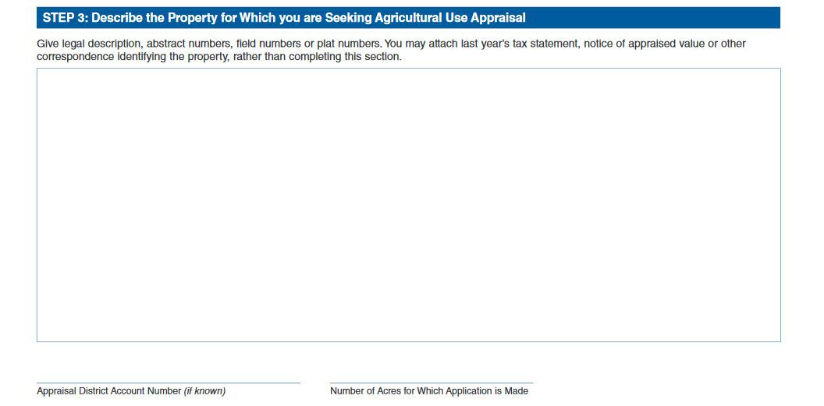
Complete STEP 3
EXAMPLE A:
MILLER, Blk: 10, Lot: 1
MILLER, Blk: 10, Lot: 2
MILLER, Blk: 10, Lot: 3
EXAMPLE B:
H T & B RR, AB: 267, SU: 3 VICTORIA CO SL, AB: 50, SU: 516 E VICTORIA, AB: 647, SU: 2
VICTORIA CO SL, AB: 499, SU: 509 W G LYKES, AB: 1364, SU: 511
R1234 or R000001234
100
Enter the location information that pertains to the land you wish to qualify for special use ag appraisal. This detail is included in the letter accompanying your form.

Slide 8
Complete STEP 3 (continued)
X
X
X
Mark “Yes” or “No” for all three questions as applicable. These will dictate what you need to fill out in subsequent sections, so don't skip anything.

Slide 9
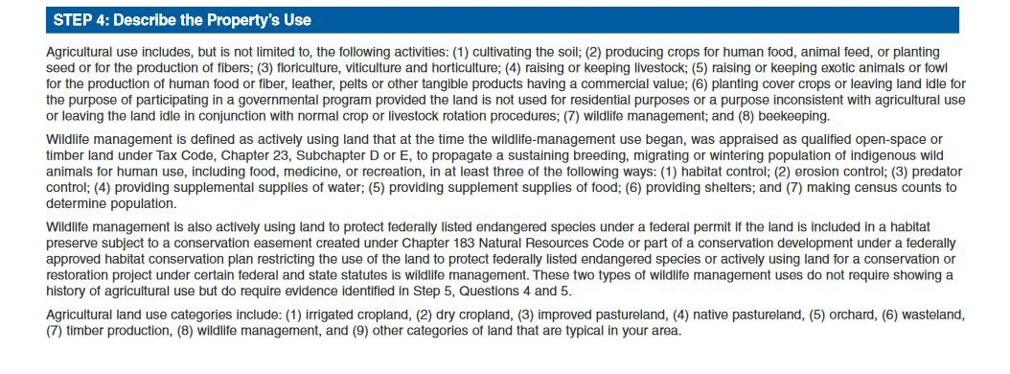
Complete STEP 4
Read the instructions thoroughly. If you still have questions related to whether your use of the land may qualify, please feel free to contact our office.

Slide 10
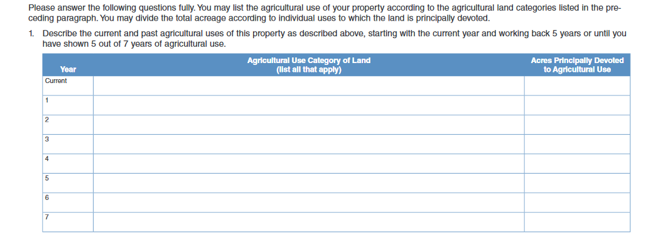
Complete STEP 4 (continued)
2016 | Native Pasture - Cattle | 100
2015 | Idle | 100
2014 | Native/Improved Pasture - Goats | 75/25
2013 | Native/Improved Pasture - Cattle | 75/25
2012 | Native/Improved Pasture - Cattle | 75/25
2011 | Idle | 100
Enter the year and all applicable ag use of the land you wish to qualify. It's extremely important to be specific and make sure the total acreage you enter here equals the acreage entered in Step 3. Some examples have been provided to give you some guidance, but this is by no means a comprehensive list.

Slide 11
Complete STEP 4 (continued)
Only fill out these sections IF you raise livestock, exotics, crops, or other items as applicable. If you don't, leave these sections blank.

Slide 12
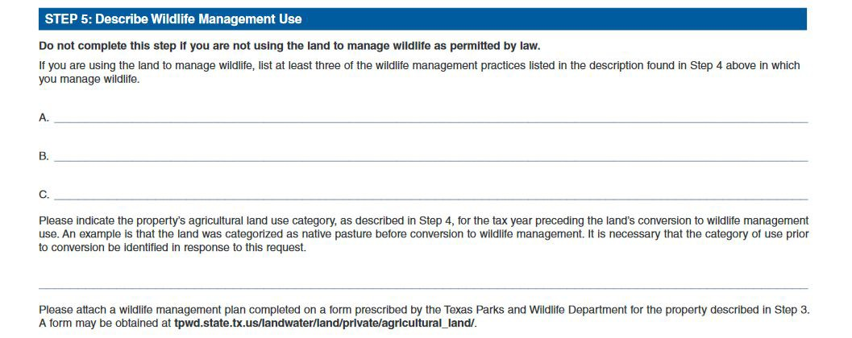
Complete STEP 5
Enter information here only if you currently follow wildlife management practices as allowed by Texas state law. We don't require you to use the Texas Parks and Wildlife Department's form to outline your wildlife management plan, but you must send us a complete and detailed plan. Failure to do so may delay or result in denial of your application.

Slide 13
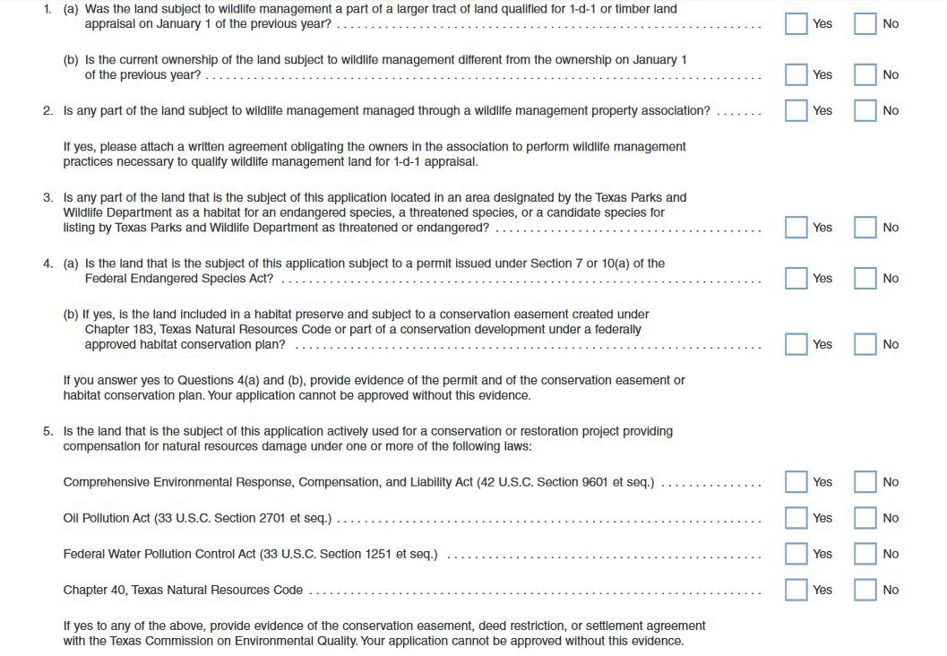
Complete STEP 5 (continued)
Again, it is not necessary to fill out any part of this section if you are not using your land for the purposes outlined here. If you meet the qualifications, simply check “Yes” or “No” as applicable.

Slide 14
Complete STEP 6
Victoria County does not currently have anyone who meets the qualifications for timber land. Therefore, leave this section blank.

Slide 15
Complete STEP 7
Print the owner's name. If the farm or ranch is owned by a trust, corporation, or other business entity, please use the name of the main owner or individual who prefers to be the point of contact. Enter their title; i.e., owner, manager, Executor, Power of Attorney, etc. Then sign and date it.
While the remainder of this form can be filled out by someone not the owner, it is very important the application is signed by the owner themselves.

Slide 16
Having completed your application successfully it's time to send it in. You can mail it to the address below or visit our office or fax it to the number listed below.
The deadline to file a timely application is
the end of April
2805 N. Navarro St. Ste. 300
Victoria, TX 77901
Fax: 361-578-1662

