Slide 2
An exemption is a deduction from taxable value
Texas offers a variety of partial or complete exemptions from local property tax
Property is taxable unless the owner shows that it meets the legal requirements for an exemption
In most circumstances, property tax exemptions require the property owner to apply

Slide 3
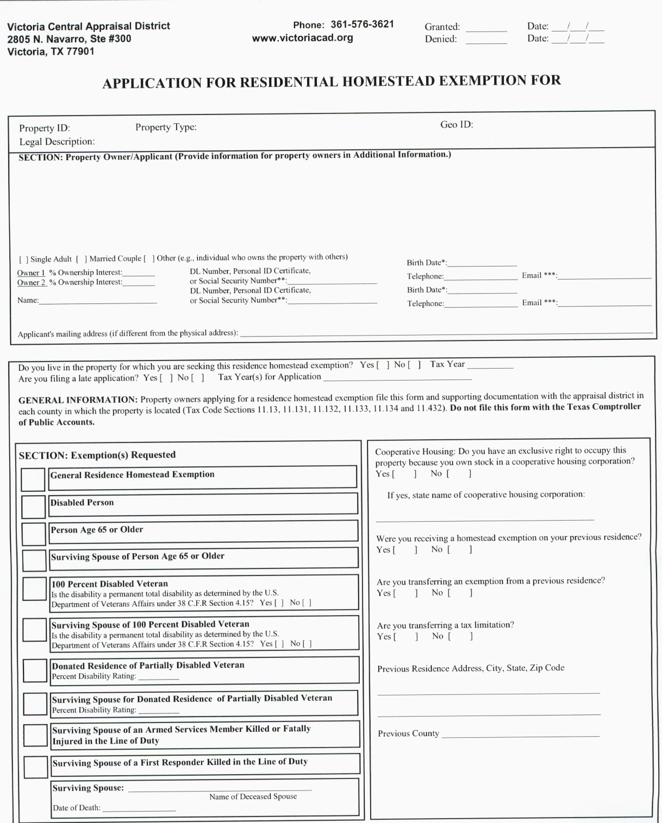
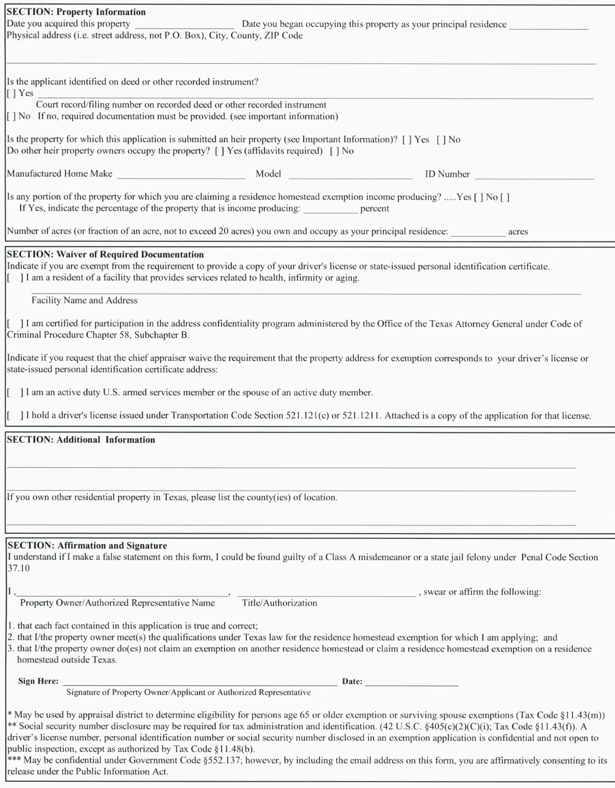
Homestead Exemption

Slide 4
Homestead Exemption
A homestead lowers the taxable value by $40,000 for school districts & $3000 off road and bridge
Other taxing units may approve an exemption not to exceed 20%

Slide 5
Homestead Limitation
Market value is what your property would sell for as of January 1
Taxable value is the value after exemptions used to calculate your property tax

Slide 6
A Homeowner Must…
Own and currently occupy the property
Not be claiming a homestead exemption on any other property
Must have a Texas State driver’s license or Texas State ID with a matching address

Slide 7
General Residence Homestead
Generally, the qualifications date is January 1 however you may be eligible for a general residence homestead as soon as you acquire a property if…
The property doesn’t have an exemption as of January 1
You are not claiming an exemption on another property as of January 1
You meet all other qualifications

Slide 8
Over 65 exemption
This exemption is for homeowners age 65 and older
Lowers the taxable value of your property by $10,000 for school districts
Establishes a tax ceiling that limits school taxes to the amount paid in the year that you first qualified (unless you significantly improve your home)
Allows you to transfer the percentage of school taxes paid to another homestead in Texas if you move

Slide 9
Over 65 exemption
To qualify …
You must be 65 years or older
Your property must be your principal place of residence
You cannot claim this exemption on any other property

Slide 10
Surviving spouse…
Of a recipient of the over 65 exemption
To qualify …
You must be 55 years or older when your spouse died
Must have been on the deed or supply a legal document transferring ownership
Your spouse was receiving this exemption or would have qualified for it the year they died

Slide 11
Disabled Person Exemption
This exemption may apply if you meet the Social Security Administration standards for disability, even if you’re not receiving benefits
It will lower the taxable value by $10,000 for school district taxes
Establishes a tax ceiling that limits school taxes to the amount you paid in the year that you first qualify

Slide 12
100% Disabled Veteran Exemption
To qualify a veteran must…
Receive 100% disability compensation due to a service-connected disability
AND
Have a rating of 100% disabled or of individual unemployability from the department of Veteran Affairs.

Slide 13
Surviving spouse…
Of a 100% Disabled Veteran
Must not be remarried
Continue to own and occupy the property
Must provide a surviving spouse letter from Veteran Affairs office with all required information

